Slide 1
Impact Evaluation Network (AIEN) ROUND II: Networks
Susan Godlonton
Markets, trade and institutions, IFPRI

Slide 2
Outline
Introduction
Estimation challenges
Existing literature: Health and Education
STATA exercise (1)
Design Exercise
In-depth paper and exercise: Worms
Existing literature: Cash Transfer Programs, Labor Markets and Microfinance
STATA exercise (2), if time

Slide 3
Introduction
Interventions typically target set of individuals, institutions or geographic areas
BUT: also have indirect effects (+/-)
Therefore, implications for correctly estimating:
Impact on eligible beneficiaries
Impact on non-eligible beneficiaries
Overall efficacy, and cost-effectiveness of program
Externalities may be important in practice and have major welfare consequences
Externalities present a range of challenges in estimation

Slide 4
Spillovers
Total
Population
Target Population
Not in evaluation
Evaluation Sample
Treatment Group
Random Assignment
Control Group
Notes:
4

Slide 5
Spillovers
Total
Population
Target Population
Not in evaluation
Evaluation Sample
Treatment Group
Random Assignment
Control Group
Notes:
5

Slide 6
Types
Biological effects
Interactions: social or economic
Behavioral effects
General equilibrium effects

Slide 7
Biological or Environmental
Many health interventions:
Indirect beneficiaries benefit due to reduced disease transmission
Deworming, Vaccinations, ARV treatment
Pollution reduction interventions
Insect eradication interventions

Slide 8
Interactions
Social or economic interactions
Pooled resources
Cash transfer programs
Education inputs: e.g. textbooks, computers
Information/ Communication
Referrals

Slide 9
behavioral
Changing norms
HIV testing
Cervical cancer screening
FGC
Notes:
(Avitabile and Di Maro, 2007) – CCSCREENING
Naguib - FGC

Slide 10
General equilibrium
Crowding out, displacement
Active labor market programs
Any program changing equilibrium market prices
Eg. Cash transfer programs; Public works programs (e.g. NREGA)
Firm level interventions
Notes:
(Angelucci and De Giorgi, 2009; Cunha et al. 2013); (de Mel et al. 2008)

Slide 11
Basic Model of Social Interactions
Studying peer effects we are interested in how individual i’s acts in response to behavior by individual j or a group of other individuals
Why might this be difficult?

Slide 12
Manski, 1993
Classic structural model for estimating social interactions
Define:
a_{i} is the action of agent i
x_{i} are the characteristics of agent I
N_{i} is agent i’s social neighborhood
$γ_{i}$ is the weight agent i attaches to the importance of each neighbor in her neighborhood
All weights need to sum to 1, i.e. $\sum_{j∈N_{i}}{γ_{ij}=1}$
Think of weights as the importance of each neighbor, in this case each neighbor has equal weight
Often don’t have data to be able to ascribe differential weights based on actual exposure, or intensity of the interaction

Slide 13
Manski, 1993
Assume:
Agent’s action is a function of the actions in her social neighborhood
$$a_{i}=α\tilde{a_{i}}+βx_{i}+β\tilde{x_{i}}+ε_{i}$$
$\tilde{a_{i}}$ = endogenous social interaction effect
$x_{i}$ = direct effect
$\tilde{x_{i}}$ = exogenous/contextual social interaction effect
$ε_{i}$ = unobserved characteristics
Note: $\tilde{a_{i}}$=$\sum_{j∈N_{i}}{γ_{ij}a_{j}}$; and $\tilde{x_{i}}$=$\sum_{j∈N_{i}}{γ_{ij}x_{j}}$

Slide 14
Manski, 1993
Exogenous effect/Contextual social interaction effect work through friends characteristics
Endogenous effect works through friends actions/behaviors; gives rise to social multiplier effect
Assume some shock to$∆ε$, and that individual i has 1 friend j
Then j’s action will be affected by $α∆ε$, that affects me
Which in turn will affect individual j by $α^{2}∆ε$, etc
Ultimately, affecting j by $\frac{1}{1−α}$ $∆ε$

Slide 15
Econometric Challenges:
Reflection problem:
Due to social multiplier, my shock is correlated with friends actions. Difficult to consistently estimate $α$.
My action affects my friend, therefore both are determined in equilibrium and both are dependent variables.

Slide 16
Econometric Challenges:
Assortativity in friendship formation:
Agents mix with agents similar to themselves.
Selection of this sort leads to correlation between $\tilde{x_{i}}$ and $ε_{i}$ and correlation between $\tilde{a_{i}}$ and $ε_{i}$
In this case neither the contextual or correlated effect can be estimated
i.e. Selection bias makes it difficult to know if two high performing students are high performing because they live together or were high performers to begin with

Slide 17
Econometric Challenges:
Common shocks
Individuals in the same neighborhood subject to correlated shocks, therefore correlation in actions.

Slide 18
Empirical identification
Manski (1993):
Endogenous: peer’s behavior affects my behavior (peer pressure, stigma, support, imitation, learning)
Exogenous/Contextual: peer’s background affects my behavior or some outside factor affects us both
Correlated: self-selection in to a group based on correlated characteristics
Notes:
MORE SLIDES HERE>>>>

Slide 19
Empirical identification
Some strategies:
Randomize social networks (e.g. dorm room assignments, classroom assignments, work assignments)
Randomize intensity of networks exposed (e.g. fraction of community provided incentive or information; fraction of school provided deworming drugs)
Extensive network data collection and structural modelling

Slide 20
Existing empirical literature
Today:
Education – focus on varying group formation
Health – biological spillovers, behavioral change, and information
Tomorrow:
Cash Transfer programs – family networks, and market prices
Labor markets – lab experiments, embedded survey experiments and firm level experiments
Microfinance – new approaches to measuring social networks

Slide 21
Education Peer effects (1)
Randomization of freshman to dormitories:
Sacerdote:
Peers have an impact on grade point average and on decisions to join social groups such as fraternities.
No residential peer effects on choice of college major.
Similar results found by Zimmerman
Both studies conducted in elite US institutions

Slide 22
Education Peer effects (2)
Randomization of school kids to tracked/untracked classrooms (Duflo, Dupas, and Kremer, 2008)
First graders in 121 schools part of the intervention: 60 schools tracked; 61 random assignment
Under random assignment: Students assigned to higher achieving peers performed better
Overall performance of random assignment was lower (by 0.14 sd)
Therefore, direct effect of high performing peers is positive, but tracking allows teachers to target teaching at more appropriate level.

Slide 23
MLSFH
Longitudinal study covering three districts in Malawi, six waves conducted between 1998 and 2010
Approximately 1 in 4 households are in sample
Two embedded randomized experiments conducted:
2004: HIV testing incentives
2006: Incentives to stay HIV negative
Pre-intervention data on many different group activities as well as GPS coordinates

Slide 24
Peer effects and HIV testing
Godlonton and Thornton (2012)
Exploit treatment intensity within different network structures
Intervention:
Individuals provided an incentive to learn their HIV status
Treatment assignment at individual level
Receiving any incentive had large impact on whether individual learnt their HIV status (Thornton, 2008)

Slide 25
Peer effects and HIV testing
Types of peers we consider:
Geographic neighbors
Religious groups
Interaction between peers and incentives

Slide 26
Peer effects and HIV testing
Positive or negative effect on own attendance
May be different by gender
Neighbors living various distances
from respondents’ households
r
r
r
r
r
H
r
r
r
r

Slide 27
Peer effects and HIV testing
$${GotResults}_{i}=α+β_{1}\%{NeighborsGot}_{i,j}+γX_{i,j}+ε_{i,j}$$
$\%{NeighborsGot}_{i,j}$= $α$+$β_{1}\%{(10−50)}_{i,j}\text{+}β_{2}\%{(50−100)}_{i,j}\text{+}$
$$β_{1}\%{(100−200)}_{i,j}\text{+}β_{1}\%{(200−300)}_{i,j}+γX_{i,j}+ε_{i,j}$$
When might the exclusion restriction be violated?

Slide 28
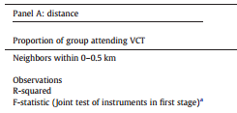
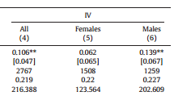
Peer effects and HIV testing
$${GotResults}_{i}=α+β_{1}\%{NeighborsGot}_{i,j}+γX_{i,j}+ε_{i,j}$$
$\%{NeighborsGot}_{i,j}$= $α$+$β_{1}\%{(10−50)}_{i,j}\text{+}β_{2}\%{(50−100)}_{i,j}\text{+}β_{1}\%{(100−200)}_{i,j}\text{+}β_{1}\%{(200−300)}_{i,j}+γX_{i,j}+ε_{i,j}$

Slide 29
Peer effects and HIV testing
$${GotResults}_{i}=α+β_{1}\%{NeighborsGot}_{i,j}+γX_{i,j}+ε_{i,j}$$
$\%{NeighborsGot}_{i,j}$= $α$+$β_{1}\%{(10−50)}_{i,j}\text{+}β_{2}\%{(50−100)}_{i,j}\text{+}β_{1}\%{(100−200)}_{i,j}\text{+}β_{1}\%{(200−300)}_{i,j}+γX_{i,j}+ε_{i,j}$

Slide 30
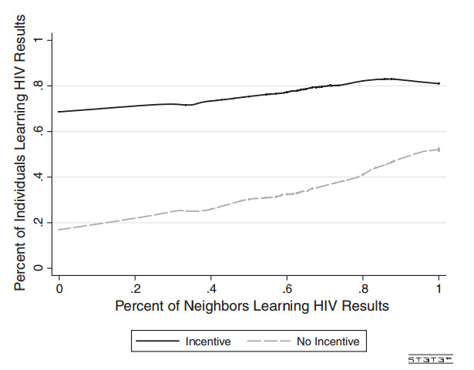
Peer effects and HIV testing

Slide 31
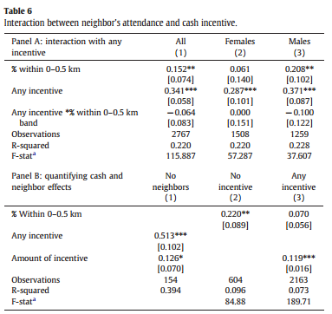
Peer effects and HIV testing
Negative interaction between peer effect and cash incentive
Col (1):
Any incentive increased learning results by 34 pp
Among those receiving no incentive, a 10 pp (~2.4 people) increase in the fraction of neighbors learning their HIV results → 1.52 pp increase in learning results
This peer effect drops to (1.52-0.64) 0.88 pp when the individual receives any incentive

Slide 32
STATA EXERCISE
CALCULATING DISTANCE MEASURES

Slide 33
Practical Considerations for DESIGN of IE
How to measure program impact in the presence of spillovers?
Design the unit of randomization so that it encompasses the spillovers.
If we expect externalities that are all within a particular sub-group (school, village):
Randomization at the level of the school/village allows for estimation of the overall effect

Slide 34
In PRACTICE: Market Prices BY TeXT (1)
The intervention:
Providing farmers with spot and futures price information by mobile phone.
Photo by IICD

Slide 35
In PRACTICE: Market Prices BY TeXT (2)
Should we expect spillovers?
Randomize: individual or village level?
Village level randomization
Less statistical power
“Purer control groups”
Individual level randomization
More statistical power (if spillovers small)
Ability to measure spillovers

Slide 36
In PRACTICE: Market Prices BY TeXT (3)
Can we do both?
Group A Villages:
SMS Price information to all individuals with phones
Group B Villages:
SMS Price information to randomly selected 75% of individuals with phones
Group C Villages:
SMS price information to randomly selected 25% of individuals with phones
Group D Villages:
No SMS price information

Slide 37
IN PRACTICE: SCHool TRACKING
Research question: To what extent does tracking students affect academic achievement?
Group A Schools:
Students randomly assigned to classes.
Group B Schools:
Students assigned to classes based on initial achievement scores.

Slide 38
IN PRACTICE: ROSCAs
Group formation of ROSCAs
Individual face similar exposure to risks, correlated risk
Relationships dependent on trust within community
MFI’s charge high fees on loans
Group lending outside of own network more effective?
Example: eMoneyPool
https://www.youtube.com/watch?feature=player_embedded&v=BTqXF9AdImk
Group A:
Allow individuals access to private money pools.
Group B:
Allow individuals access to public money pools.
Group C:
Allow individuals access to either money pool.

Slide 39
DESIGN EXERCISE
Thinking about the proposal you presented earlier this week or a new project you might be interested in conducting, consider the case (where you are unrestricted ito funding, or logistical constraints), how could you modify your design to directly measure and account for social network effects?
TIME: 15 MINUTES to work on it
SHARING TIME

