Slide 1

Impact Evaluation and Analysis of Development Interventions
Managing and minimizing threats to analysis
Ruth Vargas Hill, IFPRI

Slide 2
Introduction
Researcher at IFPRI in the markets, trade and institutions division
Research work focused on looking at how to develop markets for rural households
  Financial markets (insurance)
  Output marketing institutions (contract farming, farmers groups)
Requires randomization of choices that farmers face (markets) not programs that they are provided (such as social protection programs)

Slide 3
Evaluation in markets
Because randomization is of choices not programs issues of imperfect compliance become really important.
  Not everyone is likely to take-up the intervention being offered so what does this mean for analysis
Network effects are really important: many market and financial transactions in rural areas are network based, so economic spillovers as well information spillovers are high
  Understanding how to treat spillovers is important

Slide 4
Evaluation in markets (cont)
Because the unit of analysis is often a market or a group, and because there are few market participants, the N over which randomization occurs can be quite low:
  Need strategies to help ensuring balance and power to ensure that our studies have internal validity and show useful results.
As with all studies issues of attrition and protocol adherence are also important.

Slide 5
Outline
Small N
  Randomized but not balanced? (today)
  Choice and measurement of outcomes (tomorrow)
Attrition (today)
Spillovers (today)
Partial compliance and selection bias (today)
Protocol adherence (today)

Slide 6
Outline
Randomized but not balanced?
Attrition
Spillovers
Partial compliance and selection bias
Choice and measurement of outcomes
Protocol adherence
External validity

Slide 7
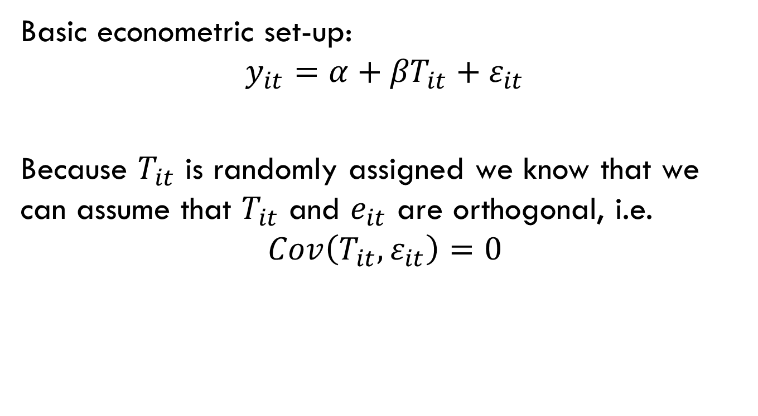
Balance
Basic econometric set-up:
$$y_{it}={α+βT}_{it}+ε_{it}$$
Because $T_{it}$ is randomly assigned we know that we can assume that $T_{it}$ and $e_{it}$ are orthogonal, i.e.
$$Cov\left(T_{it}, ε_{it}\right)=0$$

Slide 8
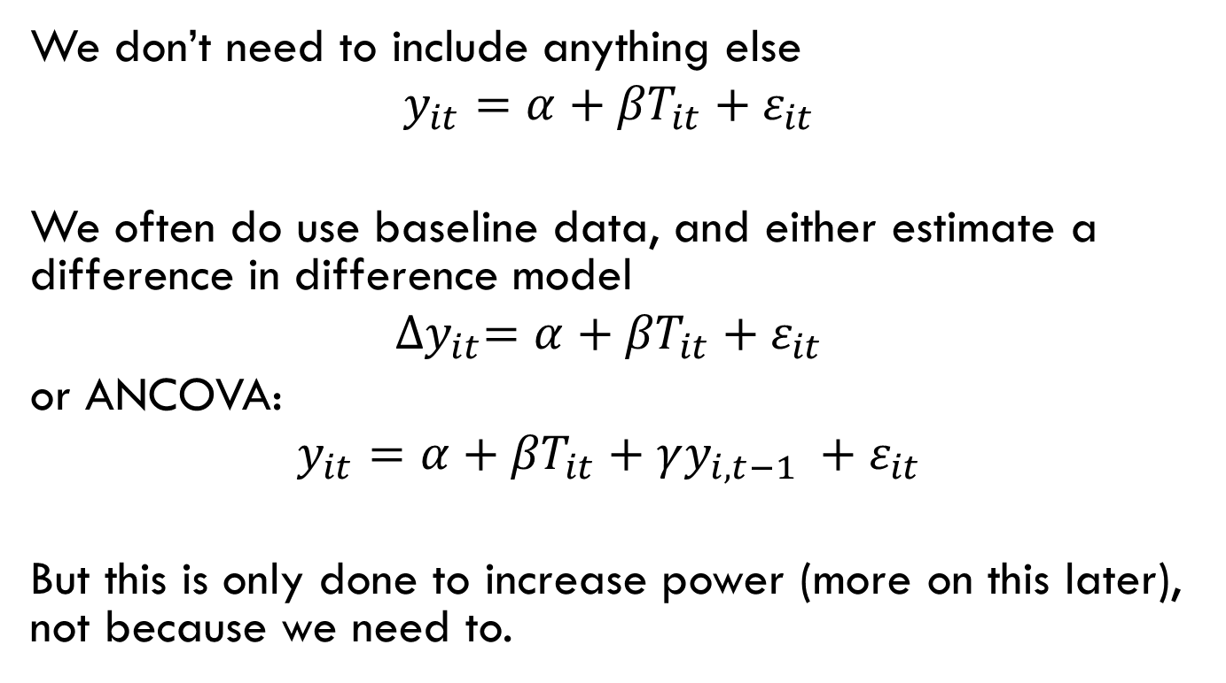
Balance
We don’t need to include anything else
$$y_{it}={α+βT}_{it}+ε_{it}$$
We often do use baseline data, and either estimate a difference in difference model
$${∆y}_{it}={α+βT}_{it}+ε_{it}$$
or ANCOVA:
$$y_{it}={α+βT}_{it}+γy_{i,t−1} +ε_{it}$$
But this is only done to increase power (more on this later), not because we need to.

Slide 9
Testing balance
Often one of the first tables in a paper/report on an RCT is a table showing that the control and treatment groups are “balanced” across key characteristics.
Choose a set of characteristics.
Dichotomous treatment variables: test the equality of means and/or medians for the two treatment groups.
    Use mean and lincom commands (no strata)
    svy: mean characteristic, over(treatment)
    lincom [characteristic]0-[characteristic]1
    Use regress command (can have strata also)
    svy: reg characteristic treatment
    svy: reg characteristic treatment i.strata

Slide 10
Testing balance
For continuous treatment variables (e.g. price discounts), regress the continuous treatment on the characteristic of choice.
    Use regress command (can have strata also)
    svy: reg characteristic treatment
    svy: reg characteristic treatment i.strata
Can use the median command in stata to test whether medians are significantly different if outliers are of concern.

Slide 11
Imbalance: risks
Balance is ensured if we randomize over a large N (where N is the unit of randomization)
However for smaller N this may not be the case
But balance is the key assumption!
Are respondents balanced on key variables (especially outcome variables) between treatment and control?
  Tests of balance involve comparing differences in means of observed characteristics between treatment and control groups
  Good indication of balance, although will not be balanced on all observables. For 10 variables, would expect one to be significant at 10 percent level.

Slide 12
Imbalance: solutions
Re-randomize: keep reallocating to treatment and control until everything (or as much as possible) balances
  Not really a valid approach: balance on observables does not guarantee balance on unobservables (and we care equally about these).
  not possible if lottery is being drawn in the field
Stratification and pairwise matching are preferred:
  To increase balance on important characteristics (e.g. outcome variables)
  Balance on unobservables is not improved in this method
Reference: Bruhn and McKenzie. 2009. “In pursuit of balance: randomization in practice in development field experiments” Amer. Econ. J.: Applied Econ.

Slide 13
Threats to balance after randomization
We assume groups are equivalent at the beginning of treatment.
AND that they remain equivalent, other than treatment, throughout the study period.
What can cause this not to be true?
  Additional interventions targeted to those that are in the treatment group.
  People in the treatment or control group can differentially drop out (attrition)

Slide 14
Stratification
Also called blocking
Use baseline characteristics to split the sample up into strata or blocks. Eg:
  Gender: women and men
  Gender and above/below median age: old women, young women, old men, young men
Randomize within each block:
  Let δ be the proportion of total N to be treated, N₁ of which are women, N₂ of which are men.
  Select δN₁ women for treatment, select δN₂ men
Ensures balance for the characteristics which define strata
Ideally want to choose characteristics that are highly correlated with the outcome variable

Slide 15
Stratification
Quite simple, improves balance
If simple, can be done in the field and without baseline data (e.g. region, gender of participant)
Cannot be done for many variables at once, consider dichotomous variables:
  One : 2 strata
  Three: 2³ =8 strata
  Five: 2⁵ =32 strata
Control for this at analysis by including all n strata, S, as dummies in the analysis (otherwise over-estimate standard errors, and maybe bias point estimates too)
y_{ti} = α+β_{T} T_{i} + β_{S1}S_{1,i} + … β_{Sn}S_{n,i} + ε_{ti}

Slide 16
Pairwise matching
Choose a number of covariates (continuous also)
Pairs are formed to minimize the Mahalanobis distance between the values of all the selected covariates within pairs
  Greevy et al (2004): optimal multivariate matching
  King et al (2007): optimal greedy algorithm. Stata code is online in “matching_algorithm.do” in the folder at: http://www.aeaweb.org/aej/app/data/2008-0182_data.zip
One unit is assigned to treatment and one to control

Slide 17
Pairwise matching
Improves balance
Can be done for many variables at once
Provides more options for managing attrition (see future slides)
Takes time (algorithm can take many days to run)—requires baseline data sometime in advance of randomization
Cannot be done in the field
Control for this at analysis by including all n pair dummies, P, as dummies in the analysis (otherwise over-estimate standard errors)
y_{ti} = α + β_{T} T_{i} + β_{P1}P_{1,i} + … β_{Pn}P_{n,i} + ε_{ti}

Slide 18
Outline
Randomized but not balanced?
Attrition
Spillovers
Partial compliance and selection bias
Protocol adherence

Slide 19
Attrition
Turn to your neighbor and discuss a project in which there has been a follow-up exercise of some kind and you have had a large amount of attrition (people disappearing)
What was the main cause of attrition?
Why might attrition in the context of an RCT be a problem?

Slide 20
Attrition: risks
Is it a problem if some of the people in the experiment vanish before you collect your data?
  It is a problem if the type of people who disappear / appear is correlated with the treatment (and you want to do more than measure the rate of disappearance / appearance)
Notes:
20

Slide 21
Attrition bias: an example
The problem you want to address:
  Lack of price information causes farmers to sell to traders at the farmgate rather than in the nearby market.
You start a price information program and randomize markets and their surrounding villages to treatment and control. You expect the following effects:
  Increased quantities sold: farmers sell more when they can bargain for a higher price (Key, Sadoulet and de Janvry)
  Increased sales at the market: particularly, farmers with smaller amounts of crop to sell start going to the market more when they know the price is higher (Key, Sadoulet and de Janvry, Hill and Fafchamps)
Notes:
http://www.povertyactionlab.org/
21

Slide 22
Attrition bias: an example
You go to the markets (treatment and control) and record all farmer sales in a given month
Will the treatment-control difference be accurately estimated for both outcomes?
Notes:
http://www.povertyactionlab.org/
22

Slide 23
Actual difference in quantity sold
Notes:
23

Slide 24
Actual difference in quantity sold
Notes:
24

Slide 25
Difference measured at the market
Notes:
25

Slide 26
Difference measured at the market
Notes:
26

Slide 27
Attrition: solutions
Avoiding attrition:
Don’t rely on measures taken at a place where you think you will see attrition, measure where you think attrition will be the lowest:
  E.g. survey farmers at home rather than at the market when you think the intervention will have an impact on where farmers sell.
Devote resources to tracking participants
Notes:
http://www.povertyactionlab.org/
27

Slide 28
Attrition: solutions
Handling remaining attrition
If there is still attrition, check that it is not different in treatment and control. Is that enough?
Also check that it is not correlated with observables.
Still could be correlated with unobservables, so try and bound the extent of the bias.
Notes:
http://www.povertyactionlab.org/
28

Slide 29
Attrition: bounding the extent of the bias
suppose everyone who dropped out from the treatment had the lowest outcome that anyone got; suppose everyone who dropped out of control got the highest outcome that anyone got…
  Why does this help?
Notes:
http://www.povertyactionlab.org/
29

Slide 30
    Attrition and pairwise matching
 | ATE for full sample | ATE on those who did not drop out | ITT
Attrition is random and treatment effect is constant across population | Drop a pair from analysis if one of the two partners drops out—increases power | Drop a pair from analysis if one of the two partners drops out | Use full sample
Treatment effect is heterogeneous | Use full sample | Drop a pair from analysis if one of the two partners drops out | Use full sample
Attrition is not-random | Use full sample | Drop a pair from analysis if one of the two partners drops out | Use full sample

Slide 31
Outline
Randomized but not balanced?
Attrition
Spillovers
Partial compliance and selection bias
Protocol adherence

Slide 32
Spillovers
For some interventions spillovers are likely. Particularly in interventions that address markets…
Turn to your neighbor and discuss a development projects you have been involved in in some way where there were substantial spillovers—i.e. the program had impact (positive or negative) on people other than those who received the program.
How might this affect an evaluation of the program?

Slide 33
Spillovers: risks
If spillovers are not taken into account in the randomization design and those with the program are compared to those who were affected by program spillovers, the measured program impact will
  underestimate the direct program impact (positive externalities)
  overestimate the direct program impact (negative externalities)
Spillovers affect estimation of impact, but they are also interesting in and of themselves and RCTs can help estimate spillovers.

Slide 34
Spillovers example: economic
Assess the impact of insurance on welfare outcomes among farmers.
In the absence of insurance households in a village provide loans and gifts to households that experience bad events during an ag season
Insurance will likely affect this:
  Those with insurance will receive payouts during bad years, there may be more to share with other non-insured households
  Those with insurance may opt out of existing risks-sharing arrangements
Randomizing who is offered insurance at the individual level within a village will not let us estimate the impact of insurance nor will it help us understand these spillovers.

Slide 35
Spillover example: information
Assess the impact of insurance on welfare outcomes among farmers.
Provide information about insurance to randomly selected farmers in a village.
Farmers share information about new products and learn about new products from each other. Farmers without information will be likely to buy also.
Again comparing treated (those with information) to those without will not allow us to assess impact or to understand information transfer.

Slide 36
Spillovers: solutions for estimating impact
Randomize at a level which incorporates the spillover: at the village, at the group, or use distance between members.

Slide 37
Spillovers: solutions
May not have enough villages to randomize at the village level, but are concerned about spillovers within the village
Conduct an initial analysis that tells you about the nature of the spillover:
  Along what dimensions does the spillover occur?—physical distance, close relatives
  Is there a “distance” beyond which spillover is unlikely?—individuals more than 2km apart, people outside your clan
Analysis provides a “distance” that can be used to generate groups where spillovers are unlikely.
Randomize on these groups

Slide 38
Distance: example 1
Background:
  Intervention to compare providing insurance to groups and individually
Risk:
  Groups do not stay within village boundaries, cannot randomize at the village
  Randomizing at the next level up (kebele) implies working on a scale that is too large for the MFI

Slide 39
Distance: example 1
Solution:
  Conduct a baseline network map on membership of groups: which villages do farmers travel to be part of the group; questions on what determines choice of group; GPS coordinates of all villages
  Probability of membership in a village more than 2km away is very unlikely, given regular attendance at meetings and funerals is required
  Select villages for randomization that are more than 2km apart.

Slide 40
All villages

Slide 41
Select first village

Slide 42
Drop villages within a 2km radius

Slide 43
Drop villages within a 2km radius

Slide 44
Select second village

Slide 45
Drop villages within a 2km radius

Slide 46
Drop villages within a 2km radius

Slide 47
Repeat until enough study villages are selected

Slide 48
Randomize treatment across study villages
C
T
T
C
T
C
T
C
T
C
C

Slide 49
Distance: example 2
Background:
  Intervention in Tanzania to look at impact of incentive schemes between a milk company and farmers.
  Randomly selected farmers given a new incentive scheme that rewards loyalty to test the scheme.
Risk:
  Spillovers are possible: those with an incentive can deliver milk on behalf of others.
  The firm is only operational in 10-12 villages, randomization at the village level is not possible.

Slide 50
Distance: example 2
Solution:
  Analysis of baseline data suggests that delivering on behalf of others occurs within a clan, but rarely outside of a clan.
  Randomize at the clan level.
  Collect data on GPS coordinates of clans.

Slide 51
Learning about spillovers
Design randomization to learn about spillovers
Define the network: often geographically defined, but other definitions may be important
Key: treat only some people within the network
Three groups:
  Treated (T)
  Untreated in the network of those that are treated (UT)
  Control (C)
Assess impact on untreated individuals in networks by comparing UT to C.

Slide 52
Learning about spillovers
Treating some people in a network:
  Select treatment network and randomly select only some members for treatment
  Randomly select individuals/villages, and collect data on networks at baseline in order to define untreated that “know” treated. [Use proportion, otherwise picking up those in high density areas or those with larger networks]
When not geographically defined, collect data on networks at baseline
  Networks may also change as a result of intervention, evidence to suggest they often do
  Can’t define networks ex-post

Slide 53
Learning about spillovers
Could also vary the proportion of those treated within any cluster to vary share of network treated
This allows us to assess whether network effects are the same when many people have access to a service/market/information compared to when few people have this access.
Example:
  Control villages: no intervention
  Treatment villages A: randomly select 10 people for treatment
  Treatment villages B: randomly select 50 people for treatment

Slide 54
Learning about spillovers, example
  Gine, Karlan and Ngatia: how do farmers in Kenya learn about an insurance product? Are social network effects important? Are they equally important when marketing intensity is high and low?
  Randomize provision of comics and vouchers.
  Define clusters of households first by geographic distance.
  Treat some households in cluster, vary the proportion of households treated.

Slide 55
Learning about spillovers, example
 | Comics | Vouchers
3 in 5 people in cluster provided | Positive effect on those with comic, no effect on those without | Positive effect on those with voucher, no effect on those without
1 in 5 people in cluster provided | No effect on those with comic, no effect on those without | Positive effect on those with voucher, no effect on those without

Slide 56
Outline
Randomized but not balanced?
Attrition
Spillovers
Partial compliance and selection bias
Protocol adherence

Slide 57
Selection bias: risks
Sample selection bias could arise if factors other than random assignment influence program allocation
  Even if intended allocation of program was random, the actual allocation may not be
57
Notes:
http://www.povertyactionlab.org/
57

Slide 58
Selection bias: risks
Individuals assigned to comparison group could attempt to move into treatment group
Alternatively, individuals allocated to treatment group may not receive treatment (partial compliance)
Can you just compare beneficiaries and non-beneficiaries anyway? Why not?
58
Notes:
http://www.povertyactionlab.org/
58

Slide 59
Selection bias: risk
Target Population
Not in evaluation
Evaluation Sample
Random Assignment
Treatment group
Participants
No-Shows
Control group
Non-Participants
Cross-overs
59
Notes:
59

Slide 60
Selection bias: solutions
Perhaps the best solution for selection bias is to try and ensure selection occurs as much as possible prior to the intervention.
  Farmers select into a training program before training is given, training (or timing of training is then randomized).
  Farmers apply for an agricultural loan, a random selection of farmers are provided with the loan.
Not always possible.

Slide 61
Selection bias: solutions
Intent to treat (ITT):
  Average impact of program in practice: treats all noncompliars as treated, and treats all crossovers as remaining in the control
  Problem: power is reduced by noncompliance and does not provide an idea of what the average impact of the program on the treated is.

Slide 62
Intent to treat
Instead of randomizing treatment (T), we randomized assignment/eligibility (Z)
  e.g. we randomized access to improved seeds rather than whether or not they used improved seeds.
We can estimate the impact of assignment to treatment, this is called the intent to treat.
Z replaces T in the previous regression models.
y_{ti} = α+ β_{z} Z_{i} + ε_{ti}
This may often be what we want to estimate, as the effect of a policy is often the impact of Z.

Slide 63
Selection bias: solutions
Sometimes we want to know the impact of the treatment, e.g. what actually is the impact of improved seeds on farmer yields and crop revenue.
Treatment on the treated (ToT):
  Instruments for take-up with assignment: gives an idea of the average impact of the program for a specific group
Encouragement design:
  To encourage compliance
  Randomize price, training activities, information provision to try and encourage higher levels of take-up in some randomly selected groups than in others

Slide 64
Treatment on the treated
Use Z as an instrument for T to estimate the LATE (local average treatment effect) – the average effect of the treatment for those who were induced into treatment by being assigned in the program.
[Here the instrument is the randomization of the program, LATE can also be used with other instruments too.]
Estimate
y_{ti} = α+ β_{T} T_{i}* + ε_{ti}
Where T*_{i} is the fitted value from the regression:
T_{i} = γ+ δ Z_{i} + μ_{ti}

Slide 65
Treatment on the treated: assumptions
Z does not have a direct effect on y other than through T
  Not always the case: spillovers? Can also be a program effect even if full treatment is not selected into (information about improved farming practices even if did not use improved seeds)

Slide 66
Treatment on the treated: assumptions
Z has a monotonic effect on T: the probability of being treated increases for everyone when Z=1 or the probability of being treated decreases for everyone when Z=1
  Usually the case, but worth thinking through
  It is always the case when no-one in the control group was treated. In this case the LATE gives the average effect of the treatment on the treated.

Slide 67
Outline
Randomized but not balanced?
Attrition
Spillovers
Partial compliance and selection bias
Protocol adherence

Slide 68
Protocol adherence: risks
Perfect designs can be ruined with bad implementation
  Low levels of compliance jeopardize power calculations
  Endogenous switching of treatment groups
  Differences in carefully designed interventions can change the hypothesis that can be tested

Slide 69
Protocol adherence: solutions
Implementing agency sees the benefit of randomization
Oversight of implementation as it progresses
Ensuring randomization is manageable:
  This is one reason for randomizing at the cluster, not the individual level
  Simple designs
Ensuring randomization is perceived as fair by the implementing agency and the recipients (farmers):
  Transparent lotteries, gradual rollout of program, alternative intervention for control (if appropriate)
Implementation at a manageable scale for implementing agency and oversight

Slide 70
Oversight
It is important for the evaluator to be involved with the implementation of the project in order to ensure that:
  Random assignment was adhered to
  Spillovers and non-compliance weren’t major issues
  The design of the program wasn’t changing in ways that could undermine the validity of the experiment
  Particularly at beginning, but also throughout

Slide 71
Implementing at a manageable scale
Power tests suggest more N
Ability to implement protocol correctly is important. How many villages and households can field staff reach? How well can supervisors oversee their implementation.
Operating at too large a scale for proper implementation can result in imperfect compliance and cross-overs which weaken power considerably.
Thinking of other ways to increase power is important:
  Encouragement design (to increase compliance)
  Baseline measures of outcome variables (ANCOVA estimation)
  Repeated measures of outcome variables
  Investing in more accurate collection of data on outcome variables

