Slide 1

Impact Evaluation and Analysis of Development Interventions
Increasing power through repeated measures
Ruth Vargas Hill, IFPRI

Slide 2
Choosing outcome variables
Choosing too many outcome variables will inevitably result in one of them being positive.
Tendency to do this in an attempt to find some impact!
Avoid doing this:
  Pre-specify outcomes of interest (publish protocols online)
  Report results on all measured outcomes, even null results
  Correct statistical tests
    In genetics they do this through the Bonferroni correction, this over-corrects.
    But it can be a good discipline!

Slide 3
Choosing outcome variables
However, can be easy to end up with a lot of outcomes!
Variables of ultimate interest (e.g. consumption per capita) have many determinants, so it is unlikely that the intervention will have a large detectable effect.
We will want to look at intermediate outcomes.
Intermediate outcomes can be chosen carefully by thinking through the theory of change
Stated changes:
  Back these up with measurement of the underlying change in behavior

Slide 4
Choosing outcome variables
Even when you know where you want to see impact, how do you collect data to document this?
Document behaviour, rather than perceived changes
  Respondents may be tempted to report changes in stated outcomes (did you change your behavior as a result of….) that do not reflect change in underlying behavior
  Back these up with measurement of the underlying change in behavior
Think of outcomes that are likely to be well measured
Highly variable outcomes or outcomes measured with a lot of noise, have a very large MDE for a given randomization design.

Slide 5
Working with outcomes with a high variance
Highly variable outcomes or outcomes measured with a lot of noise:
  Take repeated measures. Although be aware of increasing saliency.
  Improve accuracy of measurement with shorter recall or other means of collection (diaries, regular visits, records at marketing place of extension agent)
  Must do the same for both treatment and control.

Slide 6
Improving measurement and repeated measures
Improving measurement:
Careful supervision of surveys, use PDAs where possible, multiple questions key outcome variables
Visiting a household at the right time reduces recall error, conduct surveys after the main agricultural events to be assessed – planting, fertilizer application, harvest, sales of harvest
Visiting a household more often reduces recall error: number of loans taken in a year, number of gifts given or received.

Slide 7
Improving measurement and repeated measures
Improving measurement:
Rely on more than just survey responses: field visits, extension officer reports, MFI loan data, sales data, data collected by traders or in markets
Repeated measures:
If the outcome of interest is highly variable with little autocorrelation across time (e.g. trader sales) then repeated surveys increases power
McKenzie. 2011. Beyond baseline and follow-up. The case for more T in experiments. World Bank Policy Research Working Paper 5639

Slide 8
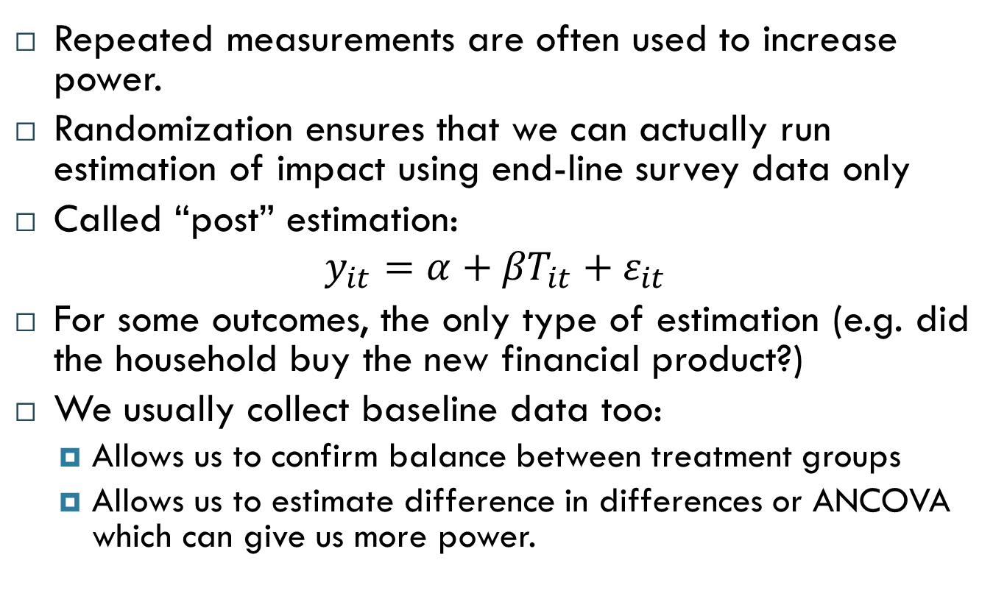
Repeated measurement is standard practice
Repeated measurements are often used to increase power.
Randomization ensures that we can actually run estimation of impact using end-line survey data only
Called “post” estimation:
$$y_{it}={α+βT}_{it}+ε_{it}$$
For some outcomes, the only type of estimation (e.g. did the household buy the new financial product?)
We usually collect baseline data too:
  Allows us to confirm balance between treatment groups
  Allows us to estimate difference in differences or ANCOVA which can give us more power.

Slide 9
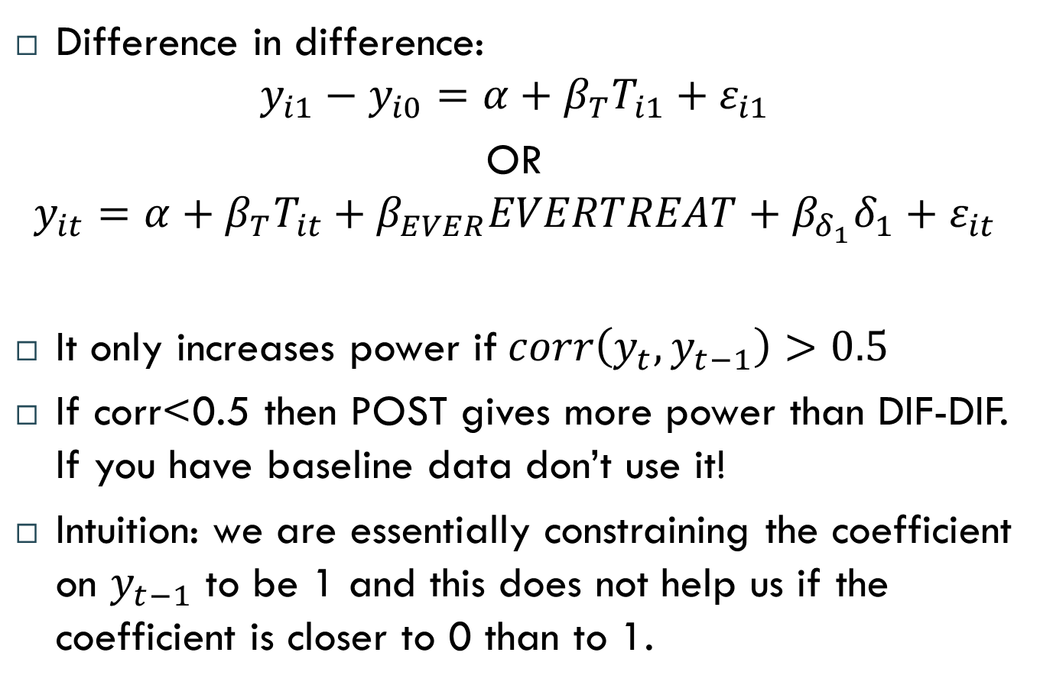
Difference in difference
Difference in difference:
$$y_{i1}−y_{i0}=α+β_{T}T_{i1}+ε_{i1}$$
OR
$$y_{it}=α+β_{T}T_{it}+β_{EVER}EVERTREAT+β_{δ_{1}}δ_{1}+ε_{it}$$
It only increases power if$corr\left(y_{t}, y_{t−1}\right)>0.5$
If corr<0.5 then POST gives more power than DIF-DIF. If you have baseline data don’t use it!
Intuition: we are essentially constraining the coefficient on $y_{t−1}$ to be 1 and this does not help us if the coefficient is closer to 0 than to 1.

Slide 10
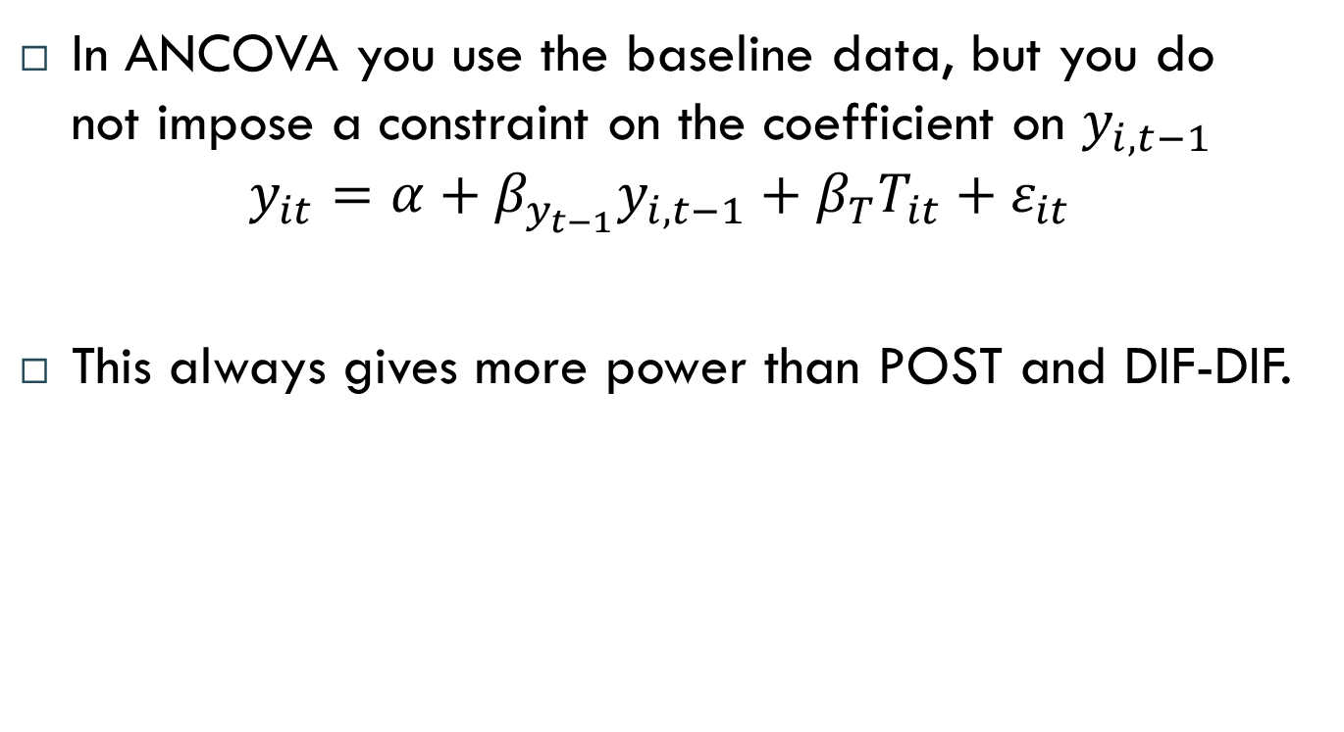
ANCOVA
In ANCOVA you use the baseline data, but you do not impose a constraint on the coefficient on $y_{i,t−1}$
$$y_{it}=α+β_{y_{t−1}}y_{i,t−1}+β_{T}T_{it}+ε_{it}$$
This always gives more power than POST and DIF-DIF.

Slide 11
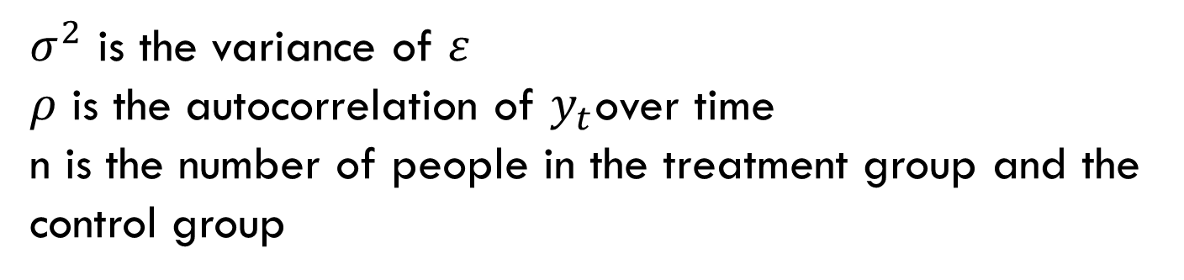
Comparing dif-dif and ancova
More power in ancova
Estimation method | m | r | Estimator | Variance of estimator
Dif-dif | 1 | 1 | (Y(T)₁ - Y(C)₁) - (Y(T)₀ - Y(C)₀) | 4σ²(1-ρ)/n
Ancova | 1 | 1 | (Y(T)₁ - Y(C)₁) - θ∗(Y(T)₀ - Y(C)₀) | 4σ²(1-ρ²)/n
$σ^{2}$ is the variance of $ε$
$ρ$ is the autocorrelation of $y_{t}$over time
n is the number of people in the treatment group and the control group

Slide 12
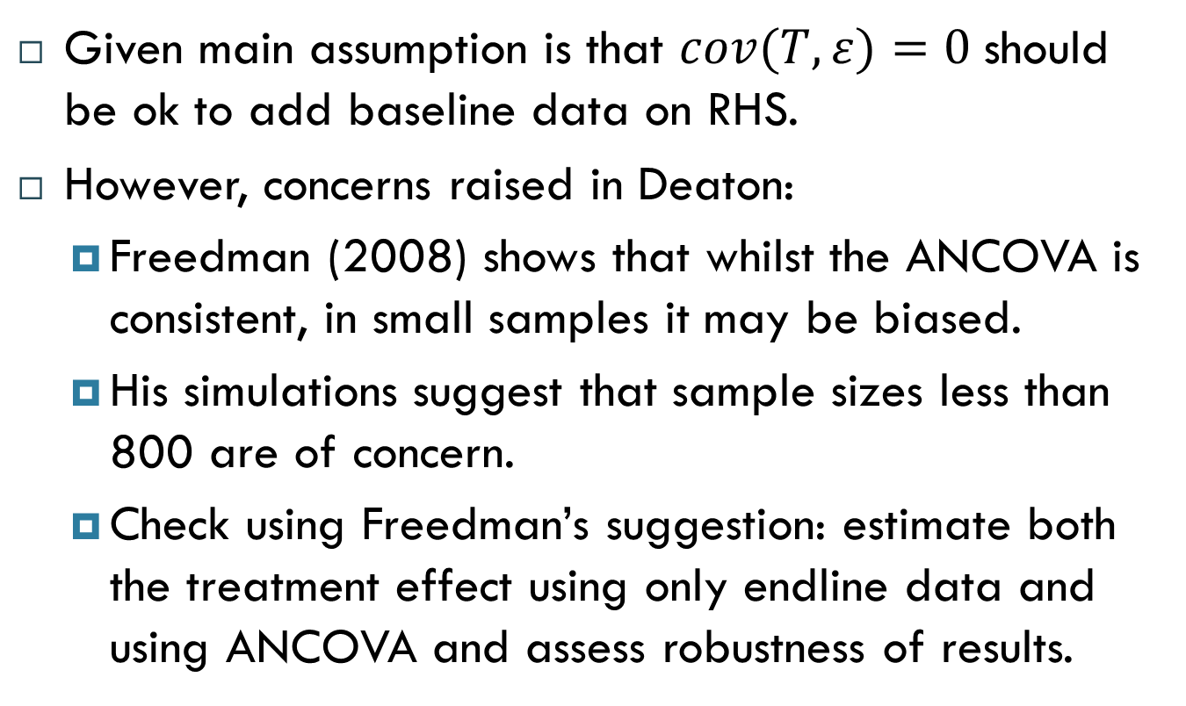
ANCOVA
Given main assumption is that $cov(T, ε)=0$should be ok to add baseline data on RHS.
However, concerns raised in Deaton:
  Freedman (2008) shows that whilst the ANCOVA is consistent, in small samples it may be biased.
  His simulations suggest that sample sizes less than 800 are of concern.
  Check using Freedman’s suggestion: estimate both the treatment effect using only endline data and using ANCOVA and assess robustness of results.

Slide 13
Other (better?) ways to use repeated measures
McKenzie. 2011. Beyond baseline and follow-up. The case for more T in experiments. World Bank Policy Research Working Paper 5639
Why do we usually only do baseline and follow-up, even when in some cases we have reason to believe the baseline data will not increase our power?
How about collecting repeated measures over time before or after the intervention?
Will that help? It might.

Slide 14
Motivation
McKenzie conducting a number of experiments on entrepreneur training and wanted to look at the impact on profits.
Highly variable outcome
  Profits vary a lot over time, some months are very good, some months are very bad
  Recall is a big problem if the recall period is too long.
Often small n
  Often not very many firms that can be randomized
  So can’t increase the n in the sample easily.

Slide 15
Two different ways to use repeated measures
Collecting data at repeated points in time after the intervention can help us see what the short and long run impact of the intervention is
  E.g. Measuring impact at 1 year and 2 years
  Here, there is no power gain. Use only t=1 for measuring impact after 1 year and only t=2 for measuring impact after 2 years.
Using multiple measures to estimate an average impact of the intervention.
  E.g. estimating impact at 9, 12 and 15 months after the intervention
  Using all measures to increase power of test of the impact after about 1 year after the intervention.

Slide 16
Two different ways to use repeated measures
Collecting data at repeated points in time after the intervention can help us see what the short and long run impact of the intervention is
  E.g. Measuring impact at 1 year and 2 years
  Here, there is no power gain. Use only t=1 for measuring impact after 1 year and only t=2 for measuring impact after 2 years.
Using multiple measures to estimate an average impact of the intervention.
  E.g. estimating impact at 9, 12 and 15 months after the intervention
  Using all measures to increase power of test of the impact after about 1 year after the intervention.

Slide 17
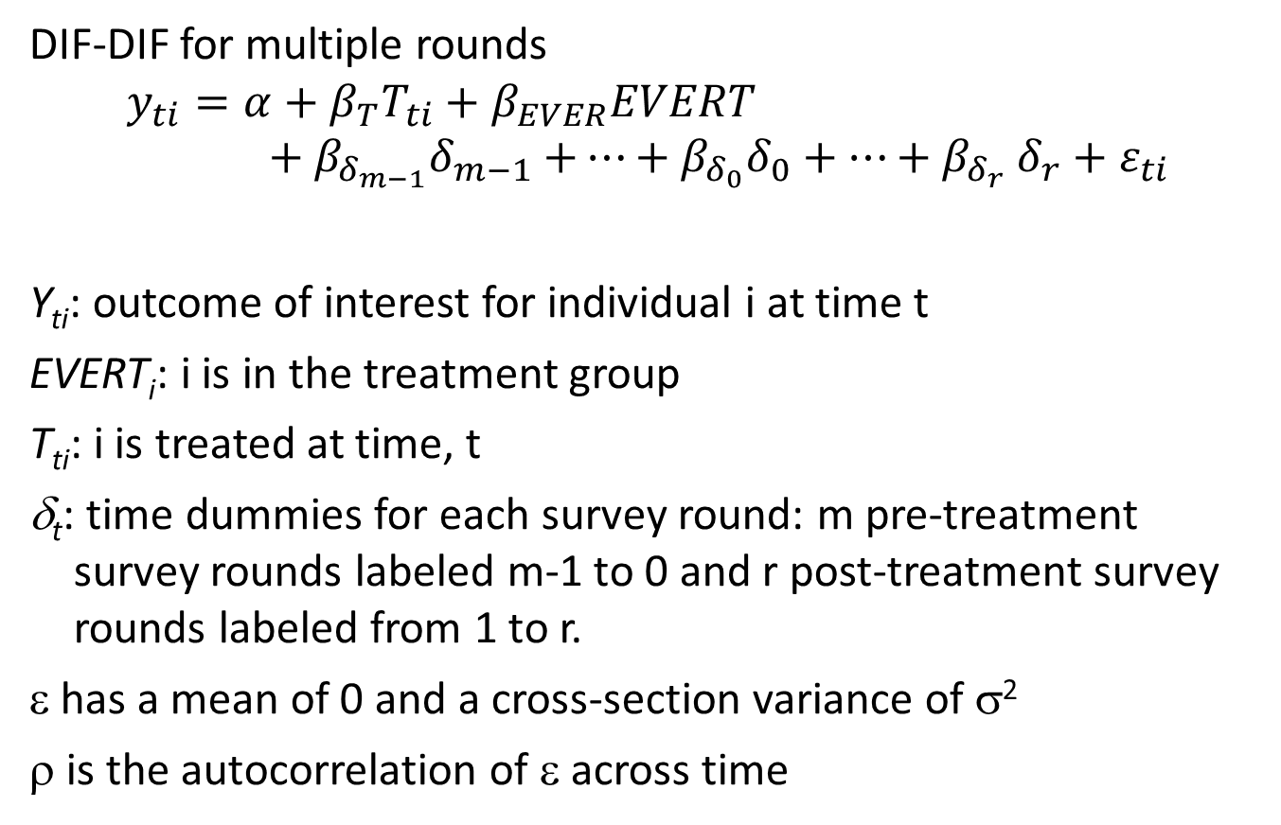
Repeated measures, DIF-DIF
DIF-DIF for multiple rounds
$$y_{ti}=α+β_{T}T_{ti}+β_{EVER}EVERT+β_{δ_{m−1}}δ_{m−1}{+…+β_{δ_{0}}δ_{0}+…+β}_{δ_{r}}δ_{r}+ε_{ti}$$
Y_{ti}: outcome of interest for individual i at time t
EVERT_{i}: i is in the treatment group
T_{ti}: i is treated at time, t
δ_{t}: time dummies for each survey round: m pre-treatment survey rounds labeled m-1 to 0 and r post-treatment survey rounds labeled from 1 to r.
ε has a mean of 0 and a cross-section variance of σ²
ρ is the autocorrelation of ε across time

Slide 18
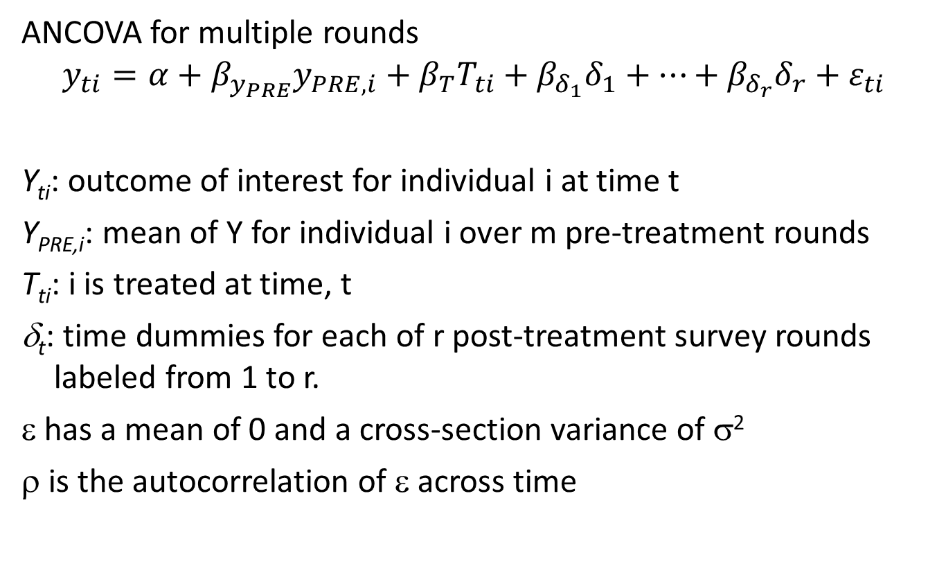
Repeated measures, ANCOVA
ANCOVA for multiple rounds
$$y_{ti}=α+β_{y_{PRE}}y_{PRE, i}+β_{T}T_{ti}+β_{δ_{1}}δ_{1}+…+β_{δ_{r}}δ_{r}+ε_{ti}$$
Y_{ti}: outcome of interest for individual i at time t
Y_{PRE,i}: mean of Y for individual i over m pre-treatment rounds
T_{ti}: i is treated at time, t
δ_{t}: time dummies for each of r post-treatment survey rounds labeled from 1 to r.
ε has a mean of 0 and a cross-section variance of σ²
ρ is the autocorrelation of ε across time

Slide 19
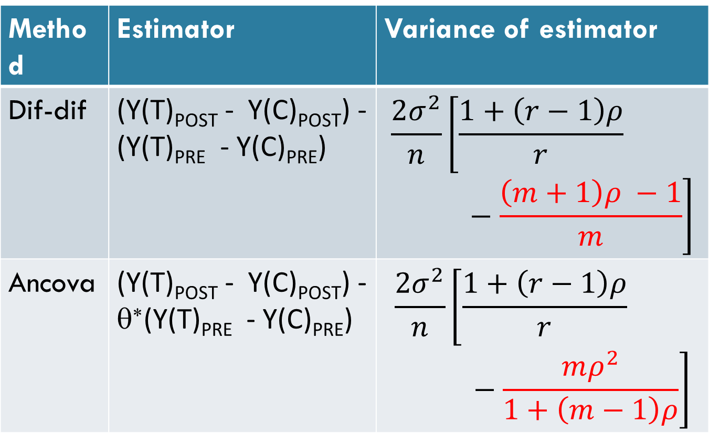
Repeated measures
Method | Estimator | Variance of estimator
Dif-dif | (Y(T)_{POST} - Y(C)_{POST}) - (Y(T)_{PRE} - Y(C)_{PRE}) | $$\frac{2σ^{2}}{n}\left[\frac{1+\left(r−1\right)ρ}{r}−\frac{\left(m+1\right)ρ −1}{m}\right]$$
Ancova | (Y(T)_{POST} - Y(C)_{POST}) - θ∗(Y(T)_{PRE} - Y(C)_{PRE}) | $$\frac{2σ^{2}}{n}\left[\frac{1+\left(r−1\right)ρ}{r}−\frac{mρ^{2}}{1+\left(m−1\right)ρ}\right]$$

Slide 20
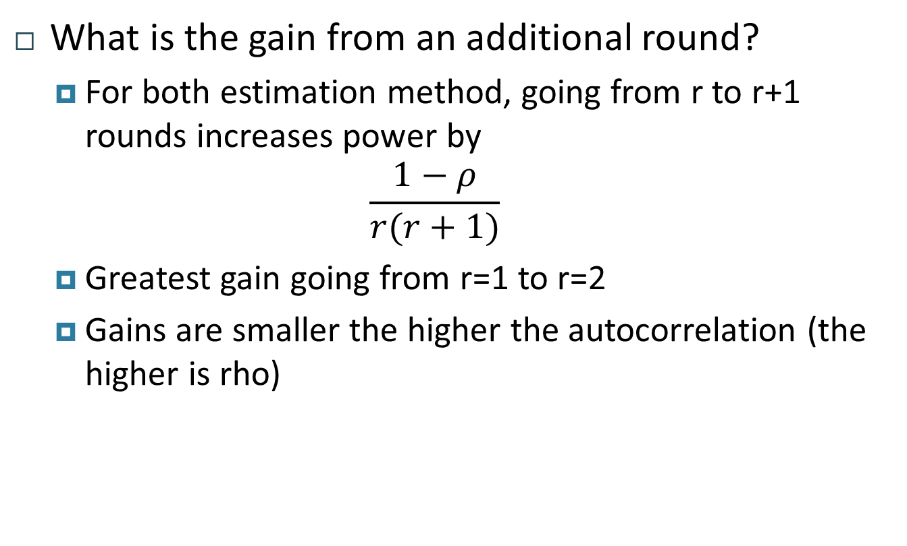
Implications
What is the gain from an additional round?
  For both estimation method, going from r to r+1 rounds increases power by
  $$\frac{1−ρ}{r(r+1)}$$
  Greatest gain going from r=1 to r=2
  Gains are smaller the higher the autocorrelation (the higher is rho)

Slide 21
Implications
How to split a survey budget between pre and post-treatment rounds?
  the lower the autocorrelation, the more post-treatment survey rounds should be conducted
  If ρ=0.25 and there is only a budget for 3 rounds, it is best to have three follow-up waves and no baseline.

Slide 22
Implications
How to choose n and T with a fixed budget for nT surveys?
  high n when ρ is high
  high T when ρ is low

Slide 23
Repeated measures: example
Tanzanian milk firm, 131 households in 77 clans in contract with the firm
Experiment to look at the best contract design
  Surveys pre and post intervention (wide variety of variables)
  Daily delivery data collected at firm for one month prior to the intervention and 3 months after the intervention (key variable of interest)

Slide 24
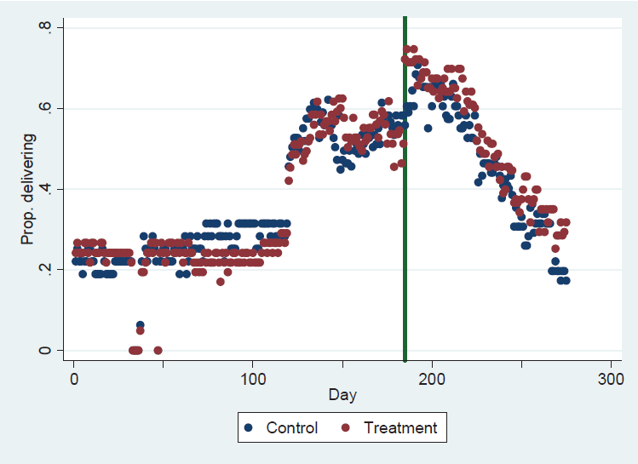

Slide 25
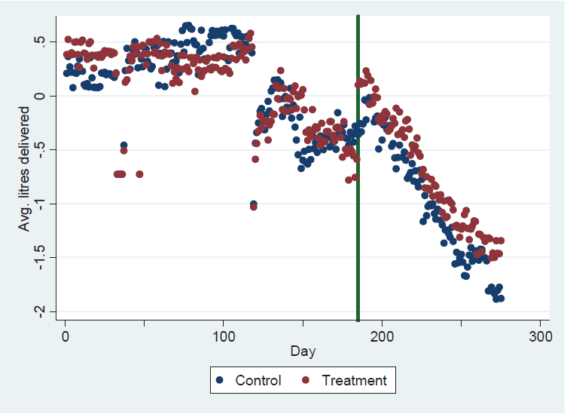

Slide 26
Repeated measures: example
Measure | Source | No. of obs per individual | Treatment effect
Prob of daily delivery | Delivery data | About 150 | 0.060*** (0.011)
Number of monthly deliveries | Delivery data | 5 | 2.275** (1.026)
Number of monthly deliveries in season | Delivery data | 2 | 2.274 (1.532)
 | Survey data | 2 | 4.125 (2.698)

