Slide 1
Learning about Agricultural Microinsurance from randomized control trials
Ruth Vargas Hill
Senior Research Fellow, IFPRI

Slide 2
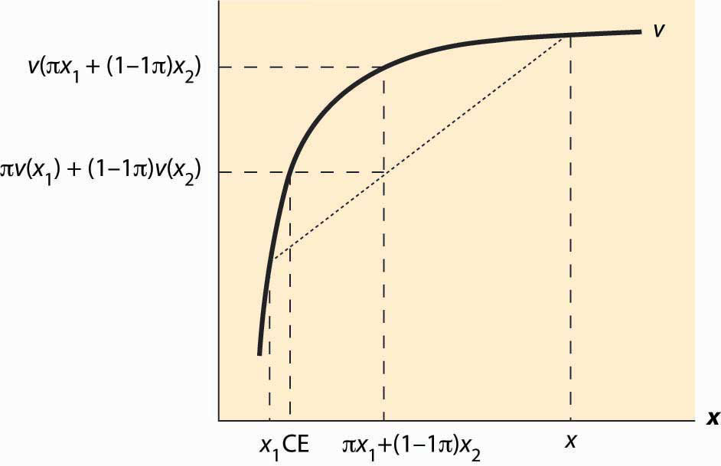
The value of insurance
Source: Chris Udry

Slide 3
Vulnerability and poverty
A characteristic of rural environments in developing countries is the uncertainty that surrounds life.
Individuals have little control over the environment in which they live, which is exemplified by low life expectancy, insecure livelihoods and crop output highly dependent on the vagaries of tropical weather.
Poverty means it is harder to deal with the bad outcomes that uncertainty can bring, and poorer households are often left trying to protect against such outcomes by avoiding risk, often at a cost.
Avoiding risk for these households means choosing their sources of income carefully to minimize fluctuations, even at the cost of lower average income.
In this way poverty and risk conflate to form a poverty trap

Slide 4
Theory (Deaton 1997)
A basic intertemporal model of consumption under uncertainty is given by maximizing the stream of future utility, U, given by
$U = E_{t} \sum_{k=t}^{T}{u\left(c_{k}\right)}$
where $c_{k}$ is consumption in period k, and $u_{k}$ is the instantaneous utility function for period k
Subject to a budget constraint and an equation that governs the evolution of assets over time:
$A_{t+1}= \left(1 + r_{t+1}\right)\left(A_{t}+ y_{t}− c_{t}\right)$
where $A_{t}$ is the real value of assets at time t, $r_{t+1}$ is the real per period interest rate from t to t+1, and $y_{t}$ is earnings in period t. It is assumed that assets are non-negative at the terminal period T.

Slide 5
Value function and maximization
The value function of this problem can be written as
$$V_{t}\left(A_{t}\right)=\max_{c}{\{u_{t}\left(c_{t}\right)+ E_{t} V_{t+1} [(1 + r)(A_{t} + y_{t} − c_{t}]\}}$$
Maximizing with respect to consumption:
$$u_{t}^{′}\left(c_{t}\right)= \left(1+r\right)E_{t}{V_{t+1}}_{}^{′}\left(A_{t+1}\right)$$
Let $λ_{t}\left(c_{t}\right)$ denote the marginal utility of consumption, this first order condition gives the following equation for how $c_{t}$ is maximized across time:
$$λ_{t\left(c_{t}\right)}= \left(1+r\right)E_{t}λ_{t+1}\left(c_{\left\{t+1\right\}}\right)$$

Slide 6
Consumption smoothing
This combined with diminishing marginal utility of consumption (which means $λ_{t}$is decreasing in $c_{t}$) means that consumption is smoothed across time until differences between two periods reflect the opportunity cost of capital.
When there are borrowing restrictions consumption is constrained in those periods. We have:
$u_{t}\left(c_{t}\right)=\min{\{u_{t}(A_{t}+ y_{t})}; E_{t}$[$\left(1 + r_{\left\{t+1\right\}}\right)u_{t+1}(c_{t+1})$]}
The borrowing constraints bind (i.e. for poorer households) the more consumption will be determined by the first term and the less smooth is consumption.

Slide 7
Empirical Evidence on Poverty and Consumption Smoothing
Wealthier households have been found to be better insured than poorer households.
Alderman shows poorer households in Pakistan are less able to insure their consumption than households in the upper income deciles (Alderman 1996)
Jalan and Ravallion also find the poor to be less well insured in China (Jalan and Ravallion 1999): the poorest 10 percent of households in rural China can protect themselves from just 60 percent of an adverse income shock-although the richest 10 percent can cope with 90 percent on average.
Dercon and Krishnan find fluctuations in adult nutrition are greater for women and individuals from poorer households in Ethiopia (Dercon and Krishnan 2000).

Slide 8
Income smoothing as a source of poverty persistence
Uninsurable risk reduces investment in activities/assets that are risky.
The degree of underinvestment increases with uncertainty, the degree risk aversion or a household's inability to insure consumption.
This is a proposed source of a poverty trap: poorer households avoid risk by reducing investment in risky but high return activities--e.g. growing drought resistant cassava rather than higher return maize. (Risk and expected return are positively correlated.)
This economic behaviour is called ``income smoothing".

Slide 9
Income smoothing as a source of poverty persistence
Rosenzweig and Binswanger (1993): an increase in risk (as measured by an increase of one standard deviation in the coefficient of variation of the date of the onset of the monsoon) leads to a 35 percent reduction in farm profits for the poorest quarter of households but has no effect on the wealthiest farmers.
Dercon (1996) showed that farmers less able to insure incomes were more likely to over-invest in safe potato production in Tanzania.
Hill (2009) showed that poorer coffee farmers in Uganda under-invested as a result of their aversion to risk.
Walker and Ryan (1990): in semi-arid India households may sacrifice up to 25% of income to reduce exposure.
Really want a better test of this. Why? These studies are based on relationship between investment and ability to insure or risk aversion. Could be other things going on.

Slide 10
Risk in agriculture
Summary:
Weather risk is a major source of risk to livelihoods of many
Bad weather results in large and long-run losses in welfare
Uninsured risk results in risk avoidance at the cost of lost income
Offer insurance
Although there are other ways that households insurance, the volatility we observe seems to come from not enough insurance in place.

Slide 11
The role of agricultural insurance
Insurance is expensive and will not be able to cover all risks
Savings and gifts/loans from friends and family can be used by farmers to cover some risks at low cost
But some aspects of agricultural risk that these financial instruments cannot manage:
Large losses (losing a large part of expected harvest)
Losses that occur in quick succession (losing crops two years in a row)
Losses that affect everyone in the same place at the same time (drought or flood or widespread pest attack)
Formal insurance can help

Slide 12
 | Year 1 | Year 2 | Year 3 | Year 4
COVARIATE (PRICES) | • • • • • • • • • • • • | • • • • • • • • • • • • | • • • • • • • • • • • • | • • • • • • • • • • • •
IDIOSYNCRATIC (ILL HEALTH) | • • • • • • • • • • • • | • • • • • • • • • • • • | • • • • • • • • • • • • | • • • • • • • • • • • •

Slide 13
 | Year 1 | Year 2 | Year 3 | Year 4
COVARIATE (PRICES) | • • • • • • • • • • • • | • • • • • • • • • • • • | • • • • • • • • • • • • | • • • • • • • • • • • •
AGRICULTURE | • • • • • • • • • • • • | • • • • • • • • • • • • | • • • • • • • • • • • • | • • • • • • • • • • • •
IDIOSYNCRATIC (ILL HEALTH) | • • • • • • • • • • • • | • • • • • • • • • • • • | • • • • • • • • • • • • | • • • • • • • • • • • •

Slide 14
Agricultural insurance
Long history of agricultural insurance. Until recently most agricultural insurance contracts were individual policies that covered farmers against multiple perils.
Multiple peril crop insurance
A farmer buys an insurance policy, reports any losses to the insurance company, insurance company sends a loss adjuster to assess the value of the loss and indemnifies this loss.
This traditional agricultural insurance is expensive:
Sending a loss adjuster to assess losses is costly. This is important to avoid moral hazard (insured individuals exert less effort)
Still some moral hazard, so the insurance is paying out sometimes when it shouldn’t
Adverse selection (only the most risky farmers seek insurance): also means there are more payouts

Slide 15
Agricultural insurance
As a result:
Insure large farmers
Insure farmers with historical records
Public subsidies to make it affordable
A problem for smallholder farmers:
Cost of sending a loss adjuster is the same for a small farmer and large farmer, but small farmer insures less and pays less premium
No historical records!
Subsidies need to be really high

Slide 16
Traditional agricultural insurance is expensive for small holders
Source: Peter Hazell

Slide 17
Indexes
Indexes can be used to capture large losses that affect everyone at the same time.
What is an index? Public information that is correlated with large losses faced by farmers.
Examples:
Rainfall recorded at a nearby weather station
Height of the river
Average yields recorded for a given area through crop cutting experiments
Satellite estimates of yield (NDVI)

Slide 18
Index insurance
An insurance policy that pays every farmer in an area, based on the performance of a publicly observable index for that area
Farmers in a district buy an insurance policy
Instead of reporting losses they receive a payout based on the performance of the index.
If the index suggests farming conditions were good there is no payout to any farmer in the district
If the index falls below a certain point (trigger point) it shows that farming conditions were bad and there is a payout to all farmers that bought a policy in the district
The payout amount and the trigger is agreed to at the time the contract is signed and is not based on any assessment of losses actually experienced by an individual policy holder.

Slide 19
Advantages and disadvantages
Advantages:
It can be much cheaper
No loss assessment
Less moral hazard and adverse selection: a farmer’s individual behavior does not affect whether or not there is a payout.
Disadvantages:
Requires difficult calibration
How do you design a policy that accurately captures when there are large losses for farmers in an area: for example what level of rainfall should payouts start at?
Even the best designed policies will have some basis risk:
The risk that the farmer does not receive a payout when he needs it or receives one when he does not need it.

Slide 20
Comparing different indexes
Index | Description | Comment
Area yield index | pays farmers on the basis of average yields recorded for a given area | good at capturing all sources of aggregate yield risk (weather, pests, input supply shocks) but not widely available
Rainfall index | pays farmers on the basis of rainfall recorded at a nearby weather station | widely available but can only cover rainfall related crop losses
NDVI | pays farmers on the basis of satellite estimates of yield cover | suitable for estimating some types of yield (such as quality of rangeland for cattle), but not for all crops.

Slide 21
The first RCTs in index insurance
Very exciting: now an agricultural insurance product for poor farmers that would solve problems of uninsured risk in agriculture
Large potential welfare effects
Exciting tests of models of agricultural household decision making under uncertainty.
Careful randomized design in Andhra Pradesh (Gine et al 2009)
Some farmers in villages offered insurance, others not.
Compare households over time

Slide 22
Gine et al 2009
No-one purchased insurance
Take-up of 5-10%
Those that bought, purchased very small amounts. Not enough to fully insure against weather risk.
No power to look at the impact of weather insurance on household decision making
Weather was good: no payouts
In fact, in most years this will be the case, as insurance policies pay out only in very bad years.
Result: not possible to look at the welfare benefits of having an insurance payout at a time of need.

Slide 23
Gine and Yang 2009
Malawi: farmers were offered:
Credit
Insurance and credit
Control
Nice opportunity to test predictions that rural households don’t take credit because they are risk-rationed (Carter)
Take-up of credit was lower in the group that were offered insurance and credit together!
The concept of limited liability was already in place in rural Malawi, so those with insurance and credit were essentially just being offered a more expensive loan.
Learnt: this was not the right test, understanding limited liability in loan markets is really important for thinking through the impact of insurance.

Slide 24
Change of focus
Why were people not buying insurance?
Studies of demand, randomize characteristics of the contract, how it is sold, what it is sold with in order to understand more about demand.
What is the broader institutional context in which households are being offered insurance, what other insurance options do they already have available to them?

Slide 25
Why would people not buy index insurance? Non-random predictions
Basis risk
A small amount really reduces demand: even 2% reduces demand from 100% to 50% (de Nicola 2011).
Farmers in Ethiopia stated that an incidence of basis risk would reduce demand by 30 percentage points (Hill, Hoddinott and Kumar 2011).
For the levels of basis risk found in some index products sold in India the optimal level of coverage is 10% when demand is actuarially fairly priced (Clarke 2011)

Slide 26
Why would people not buy index insurance? Non-random predictions
Price
In the US, area-yield insurance is less than half the price of indemnity insurance (Deng et al)
But, when the market is new and when there is little data, reinsurance costs can be really high:
In the US, area-yield insurance is priced with a multiple of 1.11.
In India, multiples can be higher than 4 (Gine et al)
A role for public policy to encourage provision of reinsurance for these products. E.g. MiCRO

Slide 27
Evidence from RCTs: price
Provide discount vouchers to:
Encourage farmers to buy
Generate good estimates of price elasticity
Issues:
How do you ensure your voucher is used by the farmer that it is provided to?
Who issues the voucher
Do you randomize at the village or household level
To what extent will farmers share information (and vouchers) between each other?
Will there be discouragement effects?
Will farmers take a village level discount seriously

Slide 28
Evidence from RCTs: price
Results: demand is very sensitive to price
Price elasticity is found to be between -0.55 and -0.98 (various studies in various countries).
Seems to be demand when reasonably priced.

Slide 29
Price elasticity

Slide 30
Evidence from RCTs: basis risk
Investments to reduce basis risk increase demand
Randomized placement of new weather stations (Mobarak and Rosenzweig 2012, Hill et al 2013)
Demand increases by 1% for every 1km closer to a weather station (India: Hill et al, 2013)
Strengthening local risk-sharing groups to manage basis risk results in a 67% increase in demand (Ethiopia: Dercon et al 2012)
But could be other things going on (see presentation tomorrow)

Slide 31
Evidence from RCTs: basis risk

Slide 32
Selected experience to date
Country | Area yield index | Weather index
India | Government insurance programme, sold to 13 million farmers a year. Largely sold as a mandated insurance policy to be taken with government loan, outside of this take-up is low. | Privately sold, part of the government programme in some states, sold to 3-4 million farmers Private: large numbers of policy holders but low penetration. Usually 5-10%, in one case 40% (with some subsidies) Private provision is expensive
Ethiopia | Recent IFPRI pilot covering 2000 farmers Penetration: 2-40% | Multiple pilots covering about 20,000 farmers Penetration: varied, dependent on some subsidies
Kenya |  | 21, 341 farmers purchasing with a package of inputs
China | People’s Insurance Company of China: rice area yield insurance in 99 counties

Slide 33
Exploring other determinants of demand in RCTs
Trust is crucially important:
The farmer puts trust in the MFI unlike credit where the MFI puts trust in the farmer!
Demand is 36% higher when insurance was offered by someone known and trusted by the household (India: Cole et al)

Slide 34
Exploring other determinants of demand in RCTs
Insurance literacy training:
Receiving intensive financial training as opposed to basic financial training increased insurance purchases by 43% -84% (China: Cai, 2011 and India: Hill, et al., 2011).
Credit constraints:
Paying after harvest at the end of the insured period can increase demand: demand tripled even with interest rates of 18% (China: Liu et al 2012)

Slide 35
Summary
Because demand has been low and studies of ATE have not been possible we have invested a lot to learn about demand
It seems that if well-designed and well-priced, and offered by a trusted agent (and preferably on credit!) index insurance will be bought.
But does it improve welfare? (the original question)
We are only starting to get answers to this

Slide 36
Welfare impact
Two studies: Karlan et al in Ghana and Cole et al in India.
Better able to invest in risky production activities:
Insured farmers more able to invest in cash crop production (India, Cole et al)
Farmers with insurance planted a larger portion of their land to crops that were more sensitive to rainfall, (Ghana, Karlan et al)
Better able to spend more on agricultural production:
Insured farmers also spent more money on inputs for cash crops (India).
Insured farmers increased expenditure on chemicals (mostly fertilizer) by 24% (Ghana)
Better able to increase scale of agricultural production:
increased the area of land cultivated by 17% (Ghana)
Harvested value was 9% higher among insured farmers in Ghana

Slide 37
Why were these studies able to estimate impact?
Large sample size
Offered free insurance
This is a wealth transfer as well as insurance
To identify the impact of insurance only those in the comparison group were given a cash payout equal to the premium value (Cole et al)
There was a pure control and a cash grant control in Karlan et al
Concerns:
Might not be the same as the impact of insurance that has to be purchased: different behavioral effect and different people that have it.
But it is a first estimate!

Slide 38
Further estimates
Karlan et al also pool results from a first year in which insurance was given and results from a second year in which insurance was sold.
In the second year, prices were randomly discounted, encouragement design.
Estimates LATE, using price of insurance as the instrument (0 in first year and discounted in years after)
Encouragement design increases power—more people buy, strong instrument to predict purchases
Repeated measures increases power

Slide 39
Conclusion
Despite much work by very good, careful researchers, we still do not have a study that has shown the impact of commercially purchased insurance on welfare.
Subsidized or free insurance is beneficial, but the question then becomes how does government investment in insurance compare to that of:
Investment in safety nets to reduce exposure to risk and improve welfare
Investment in other programs that might improve welfare

